Slide 1

Computer Communications
& Networks
CSNC-2413
Week: 07
Computer Networking: A Top Down Approach
6th edition
Jim Kurose, Keith Ross
Addison-Wesley
March 2012
Ch 3 : Transport Layer
UDP, Reliable delivery
Dr Nauman Mazhar
Faculty of Information Technology (FIT)
University of Central Punjab (UCP)

Slide 2
Chapter 3: Transport Layer
Our Goals:
Understand principles behind Transport layer services:
  Multiplexing and demultiplexing
  Reliable data transfer
  Flow control
  Congestion control
Learn about Transport layer protocols in the Internet:
  UDP: connectionless transport
  TCP: connection-oriented transport
  TCP congestion control

Slide 3
Chapter 3 outline
3.1 Transport-layer services
3.2 Multiplexing and
demultiplexing
3.3 Connectionless
transport: UDP
3.4 Principles of reliable data
transfer
3.5 Connection-oriented
transport: TCP
  segment structure
  reliable data transfer
  flow control
  connection management
3.6 Principles of congestion
control
3.7 TCP congestion control

Slide 4
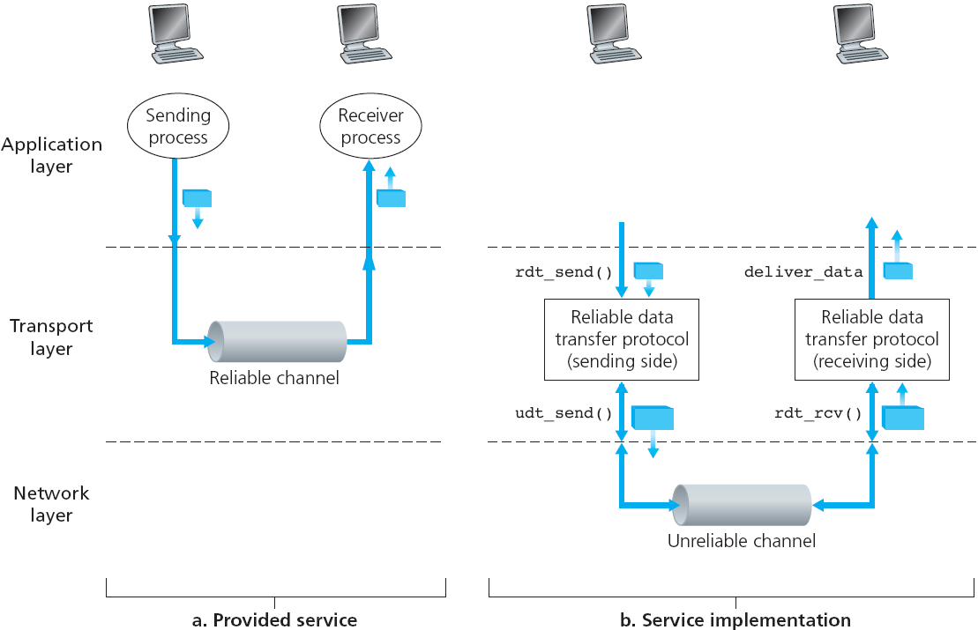
Principles of Reliable data transfer
Reliable data transfer service by Transport layer, over unreliable Network layer

Slide 5
Reliable Channel
If underlying channel is perfectly reliable…
  no bit errors
  no loss of packets
  no out of order pkt delivery
Sender & receiver just send/receive data…
  sender sends data into underlying channel
  receiver reads data from underlying channel

Slide 6
Unreliable Channel - bit errors
underlying channel may flip bits in pkts
  use checksum to detect bit errors - recall UDP checksum
  if in error drop pkt
now how to recover from errors..? need feedback..!
  Acknowledgement (ACK):
    receiver tells sender – pkt received OK – transmit next
  Negative Acknowledgement (NAK):
    receiver tells sender – pkt had errors – retransmit
two mechanisms…
  error detection thru checksum
  receiver feedback thru control msgs from rcvr -> sender (ACK, NAK)

Slide 7
A fatal flaw
What happens if ACK/NAK recvd at sender is corrupt…?
sender doesn’t know if pkt was recvd correctly or incorrectly at
receiver…
can’t transmit new pkt
can’t re-transmit old pkt
stuck..!
Sol : just retransmit old pkt…
might cause re-transmission of correctly received pkt…!!
how to handle Duplicates…!!
Handling duplicates:
sender adds Sequence Number to each pkt
if ACK/NAK garbled, sender re-transmits the pkt
receiver discards duplicate pkt due to Seq Num
(doesn’t deliver up)
Stop and Wait protocol
Sender sends one packet,
then waits for receiver
response

Slide 8
Sender receiver actions
Sender:
adds seq# to pkt
two seq# (0,1) will suffice... Why…?
must “remember” whether “current” pkt being sent is seq# 0 or 1
Receiver:
receiver can’t know if its last ACK/NAK was received OK at sender
need to check if received pkt is duplicate
  must know whether
  expected pkt seq# is 0 or 1
  duplicate not delivered up

Slide 9
NAK-free protocol
If NAKs not to be used, how can we get same functionality using only ACKs
Instead of NAK,
  receiver sends…
“ACK for last pkt received OK” – duplicate ACK
  receiver must explicitly include…
  “seq# of pkt being ACKed”
Duplicate ACK at sender results in same action as NAK (retransmit the pkt)
TCP uses NAK-free approach

Slide 10
Unreliable Channel - bit errors & pkt loss
New assumption:
underlying channel can also
“lose“ packets (Data or ACKs)
  checksum, ACKs, Seq#, retransmissions are of help
  But how to deal with pkt loss..?
  if data or ACK is lost, sender waits, then reTx
  how long to wait…?
Use Countdown timer…
sender waits “reasonable” amount of time for ACK
if no ACK received in this time, retransmit
if pkt (or ACK) just delayed (not lost)…
  reTx will be duplicate
  Seq# will handle this
What is the “right value” for timer…? depends on network conditions…!

Slide 11
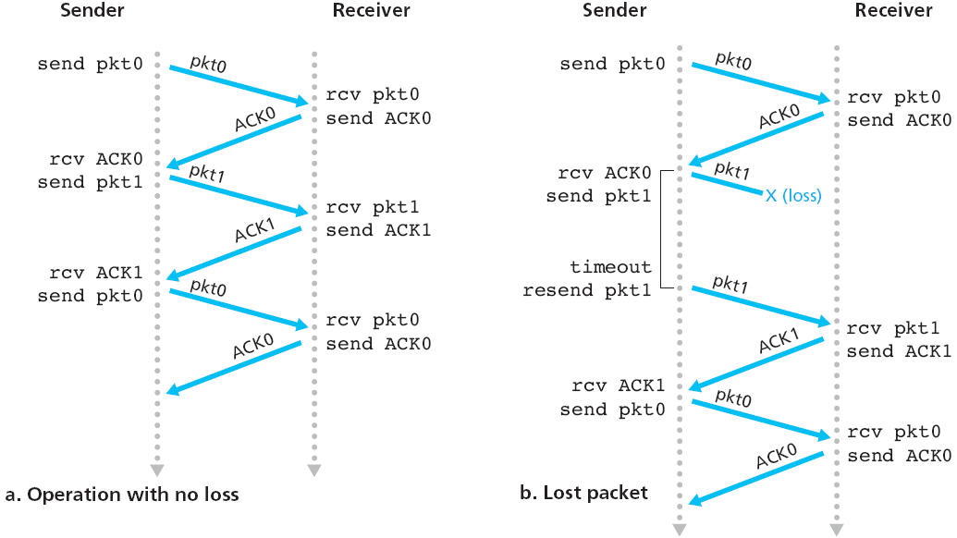
Protocol in action

Slide 12
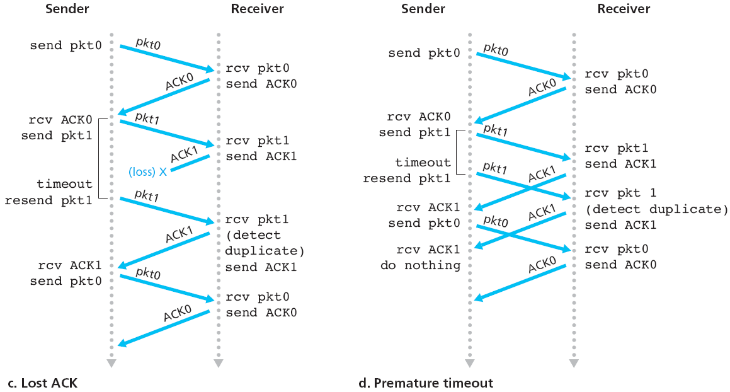
Protocol in action

Slide 13
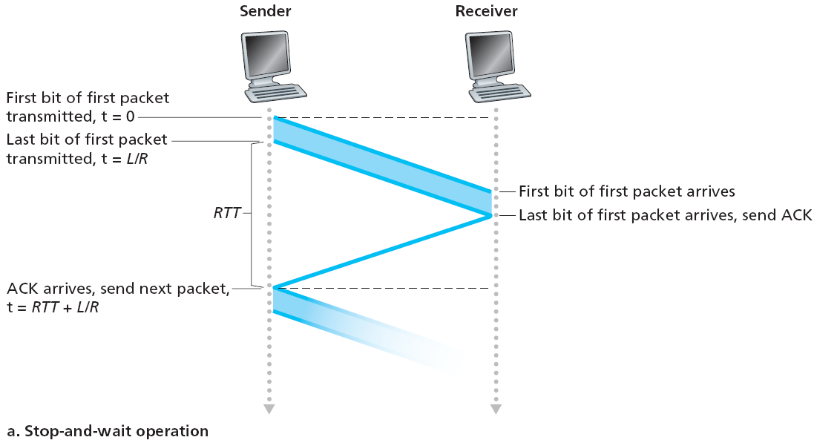
Stop-and-wait operation

Slide 14

Stop-and-wait performance
Protocol is correct, but performance poor…
For 1 Gbps link, with 15 ms prop delay, & 8000 bits pkt
L
8000 bits
D_{trans} =
=
=
8 microsec
R
10⁹ bits/sec
  U _{sender} : utilization → fraction of time sender busy sending data
  if 1KB pkt is sent every 30.008 msec :
  Thruput = data/time = (8000 bits/30.008 ms) = 266.6 kbps (too less)
network protocol may limit use of physical resources..!

Slide 15


Pipelined protocols
Pipelining: sender allows multiple “yet-to-be-Acked” pkts, considered to be “in-flight”
  increases transmission efficiency → thruput increases
  buffering at sender and/or receiver
  range of Seq Nums must be increased

Slide 16
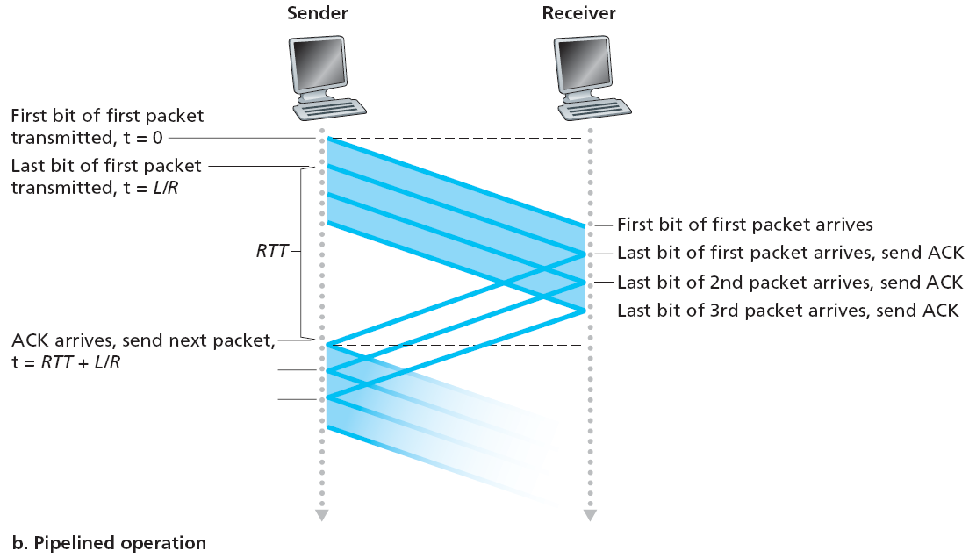

Pipelining: increased utilization

Slide 17
Pipelined protocols
Question : how many pkts to send back-to-back
Sender & Receiver agree upon a Sliding Window of size N
  sender sends upto N pkts at a time, without receiving an ACK
  “up to N unACKed packets in pipeline”
Two generic forms of pipelined protocols:
Go-Back-N and Selective Repeat
Go-back-N:
when pkt is lost,
sender retransmits all the pkts, starting from the one lost
Selective Repeat:
when pkt is lost,
sender retransmits only the lost pkt

Slide 18

Go-Back-N Protocol
sender window (N=4)
sender
receiver
0 1 2 3 4 5 6 7 8
send pkt0
send pkt1
send pkt2
send pkt3
(wait)
0 1 2 3 4 5 6 7 8
receive pkt0, send ack0
receive pkt1, send ack1
receive pkt3, discard,
(re)send ack1
0 1 2 3 4 5 6 7 8
X
0 1 2 3 4 5 6 7 8
loss
0 1 2 3 4 5 6 7 8
rcv ack0, send pkt4
rcv ack1, send pkt5
0 1 2 3 4 5 6 7 8
receive pkt4, discard,
(re)send ack1
ignore duplicate ACK
receive pkt5, discard,
(re)send ack1
pkt 2 timeout
0 1 2 3 4 5 6 7 8
send pkt2
send pkt3
send pkt4
send pkt5
0 1 2 3 4 5 6 7 8
0 1 2 3 4 5 6 7 8
rcv pkt2, deliver, send ack2
rcv pkt3, deliver, send ack3
rcv pkt4, deliver, send ack4
rcv pkt5, deliver, send ack5
0 1 2 3 4 5 6 7 8

Slide 19

Go-Back-N: sender
Pkt hdr field has k bits for 2^{k} Seq#
N ≤ 2^{k} - 1
Sender assumes “sliding window” size of N pkts
(upto N consecutive unACK’ed pkts can be sent)
Timer: for oldest in-flight pkt
ACK (n): Cumulative ACK → ACKs all pkts up to & including Seq#n
  may receive duplicate ACKs
timeout (n): retransmit pkt n and all higher Seq# pkts in window

Slide 20
GBN: receiver
If Pkt received correctly…
  send ACK for correctly received pkt
  ACK the highest, in-order Seq# pkt
If pkt received out-of-order…
  discard (don’t buffer): no receiver buffering..!
  send duplicate-ACK for the pkt recvd with the
  highest in-order Seq#

Slide 21
Selective Repeat (improvement over GBN Protocol)
Receiver individually ACKs all correctly received pkts
Sender only resends pkts for which ACK not received…
  e.g, Sender sends pkts : 1, 2, 3, 4,…., 10
  Receiver got : 2, 4, 6, 8, 10
  Sender only resends : 1, 3, 5, 7, 9
  sender timer for each pkt sent
Receiver buffers pkts, for in-order delivery to upper layer
Sender window
  N consecutive Seq#
  limits Seq# of sent, unACKed pkts
Receiver window
  N consecutive Seq#
  limits Seq# of pkts allowed to be received/buffered

Slide 22

Selective repeat in action (N=4)
Receiver window
Sender window
Under GBN, this pkt will be dropped

Slide 23

Selective repeat: sender, receiver windows

Slide 24

Selective repeat: dilemma
In pkt header field, we use
k bits to implement 2^{k} Seq#
A practical issue…!
Example:
Seq#: 0, 1, 2, 3
if window size N=3
issue: receiver sees no difference in two scenarios!
but wrongly receives duplicate data as new (in lower fig)
Q: relation between Seq# size & window size..?
pkt0 recvd, & stored correctly
pkt0 recvd, but stored incorrectly
N ≤ 2^{k}/2

Slide 25
Pipelined protocols: differences
Go-back-N:
sender can have up to N unACKed packets in pipeline
receiver sends
cumulative Acks
sender has timer for oldest unACKed packet
  when timer expires, retransmit all packets in the window, starting from unACKed packet
Selective Repeat:
sender can have up to N unACKed packets in pipeline
rcvr sends individual ACK for
each packet
sender has timer for each
unACKed packet
  when timer expires,
  retransmit only the
  unACKed packet

